Slide 1
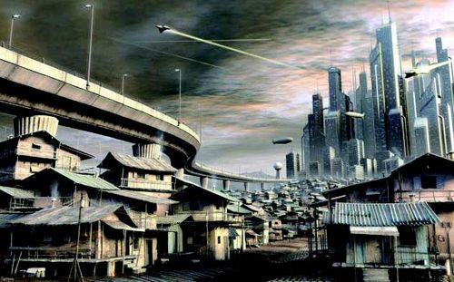
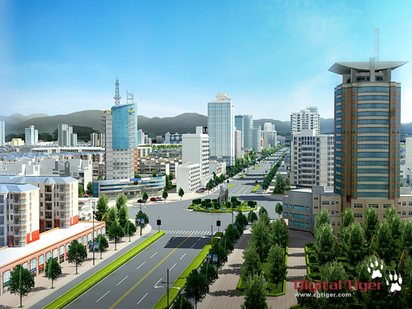
计算机高级图形学
第十章实时绘制加速技术

Slide 2

主要内容
LOD
网格压缩传输技术
遮挡剔除技术
基于图像的绘制（IBR）技术

Slide 3

实时绘制技术
利用计算机快速生成三维场景的真实感图形
  与图形硬件发展和人们对人机交互的需求密不可分
  图像绘制速度采用帧频（单位为帧/秒）来衡量
关键
  如何充分发挥图形硬件和图形算法各自长处，在绘制速度和图形质量之间取得平衡

Slide 4
图形绘制流水线
3D Geometric Primitives
常用三维图形绘制由一系列顺序的过程组成，这些过程已可部分或全部采用硬件实现，它们连接在一起称为图形绘制流水线
Modeling
Transformation
Lighting
Viewing
Transformation
Projection
Transformation
Clipping
Scan
Conversion
Image

Slide 5
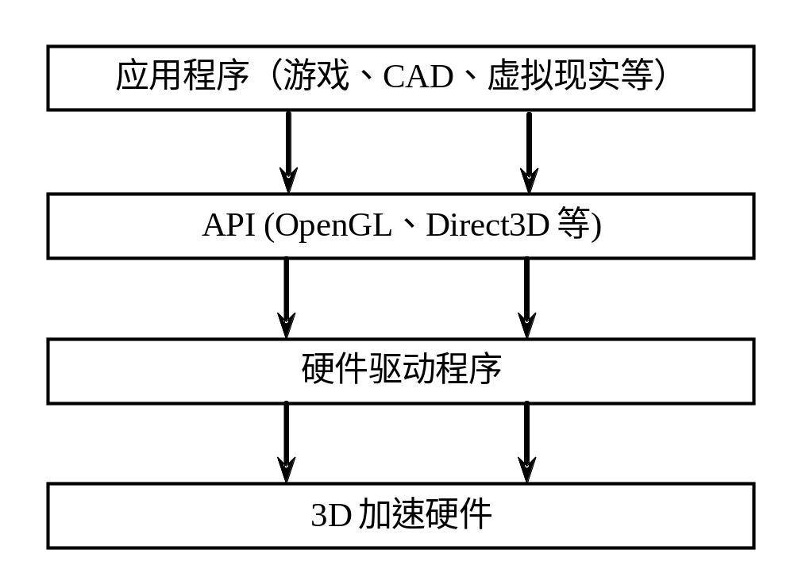
实时绘制技术
图形硬件、硬件驱动程序、图形API及应用程序间的关系

Slide 6
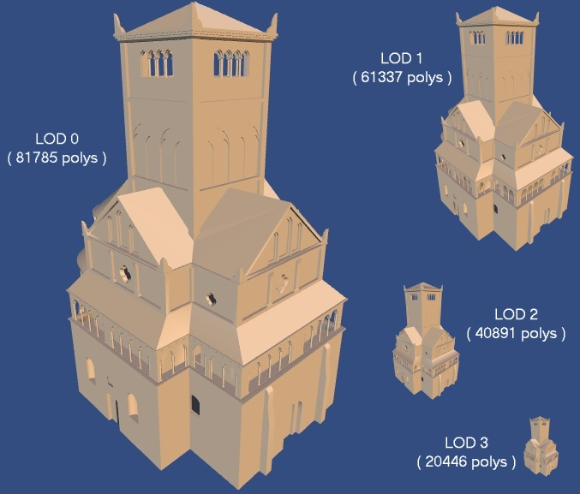
一、LOD技术
细节层次模型是以不同精度刻画物体几何细节的一组模型
基本思想
  根据物体在画面上的
  视觉重要性选取适当
  细节层次绘制该物体

Slide 7

Introduction
Level of detail (LOD) is an important tool for maintaining interactivity
  Focuses on the fidelity / performance tradeoff
  Not the only tool! Complementary with:
    Parallel rendering
    Occlusion culling
    Image-based rendering [etc]

Slide 8
The Basic Idea
The problem:
  Geometric datasets can be too complex to render at interactive rates
One solution:
  Simplify the polygonal geometry of small or distant objects
  Known as Level of Detail or LOD
    A.k.a. polygonal simplification, geometric simplification, mesh reduction, decimation, multiresolution modeling, …

Slide 9
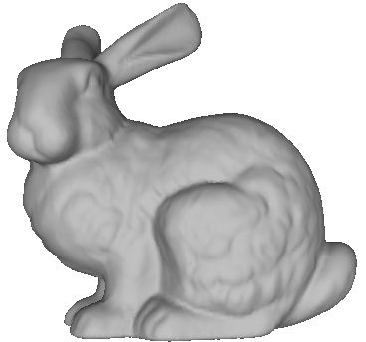
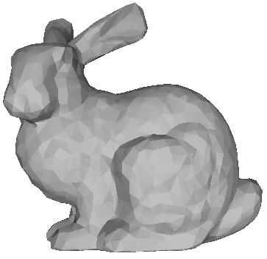

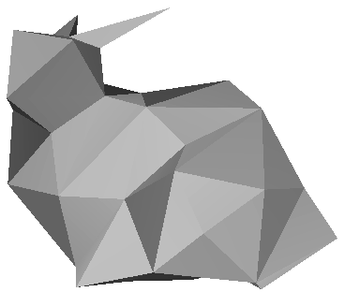
Traditional LOD In A Nutshell
Create levels of detail (LODs) of objects:
69,451 polys
2,502 polys
251 polys
76 polys

Slide 10
Traditional LOD In A Nutshell
Distant objects use coarser LODs:
Notes:
in a nutshell：简单地

Slide 11
The Big Questions
How to represent and generate simpler versions of a complex model?
How to evaluate the fidelity of the simplified models?
When to use which LOD of an object?
69,451 polys
2,502 polys
251 polys
76 polys

Slide 12
Some Background
History of LOD techniques
  Early history: Clark (1976), flight simulators
  Handmade LODs → automatic LODs
  LOD run-time management:
  reactive → predictive (Funkhouser)
LOD frameworks
  Discrete (1976)
  Continuous (1996)
  View-dependent (1997)

Slide 13
Discrete Level of Detail
Traditional LOD in a nutshell:
  Create LODs for each object separately
  in a preprocess
  At run-time, pick each object's LOD according to the object's distance (or
  similar criterion)
Since LODs are created offline at fixed resolutions, we call this discrete LOD
Notes:
Nutshell:简言之

Slide 14
Discrete LOD: Advantages
Simplest programming model; decouples simplification and rendering
  LOD creation need not address real-time rendering constraints
  Run-time rendering need only pick LODs
Fits modern graphics hardware well
  Easy to compile each LOD into triangle strips, display lists, vertex arrays, …
  These render much faster than unorganized triangles on today’s hardware (3-5 x)

Slide 15
Discrete LOD: Disadvantages
So why use anything but discrete LOD?
Answer: sometimes discrete LOD not suited for drastic simplification
Some problem cases:
  地形立交叉
  体积等曲面
  超细节范围扫描
  多个模型
Notes:
Iso-surfaces: 等值面

Slide 16
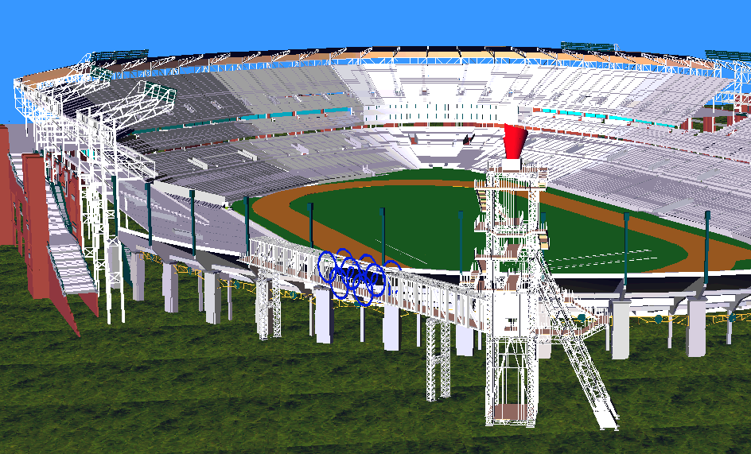
Drastic Simplification:
The Problem With Large Objects
For drastic simplification:
  Large objects must be subdivided
  Small objects must be combined
Difficult or impossible with discrete LOD
So what can we do?

Slide 17
Continuous Level of Detail
A departure from the traditional discrete approach:
  Discrete LOD: create individual levels of detail in a preprocess
  Continuous LOD: create data structure from which a desired level of detail can be extracted at run time.

Slide 18
Continuous LOD: Advantages
Better granularity → better fidelity
  LOD is specified exactly, not chosen from a few pre-created options
  Thus objects use no more polygons than necessary, which frees up polygons for other objects
  Net result: better resource utilization, leading to better overall fidelity/polygon

Slide 19
Continuous LOD: Advantages
Better granularity → smoother transitions
  Switching between traditional LODs can introduce visual “popping” effect
  Continuous LOD can adjust detail gradually and incrementally, reducing visual pops

Slide 20
Continuous LOD: Advantages
Supports progressive transmission
  Progressive Meshes [Hoppe 97]
  Progressive Forest Split Compression [Taubin 98]
Leads to view-dependent LOD
  Use current view parameters to select best representation for the current view
  Single objects may thus span several levels of detail

Slide 21
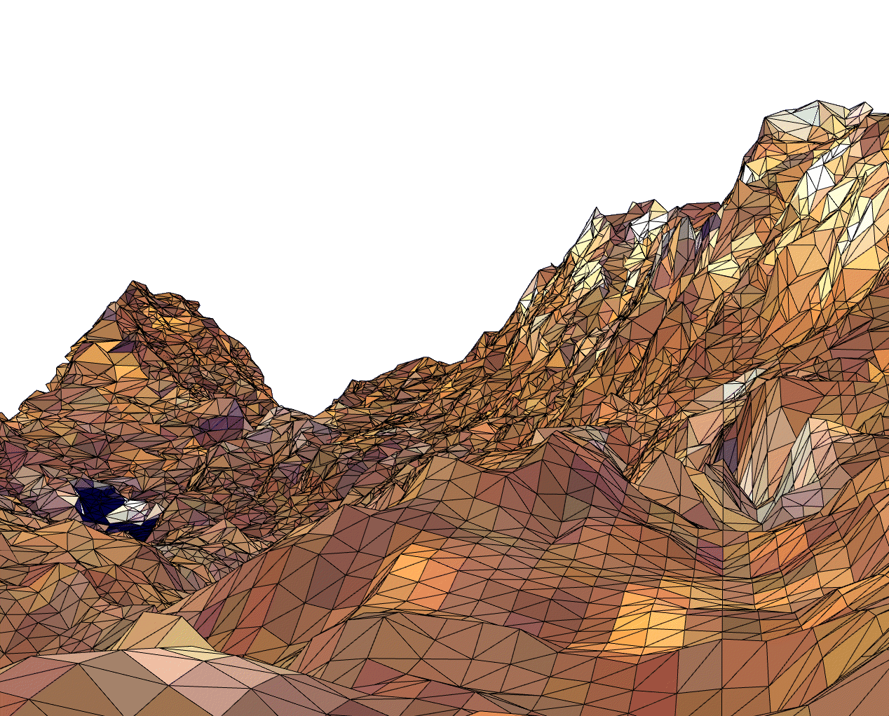
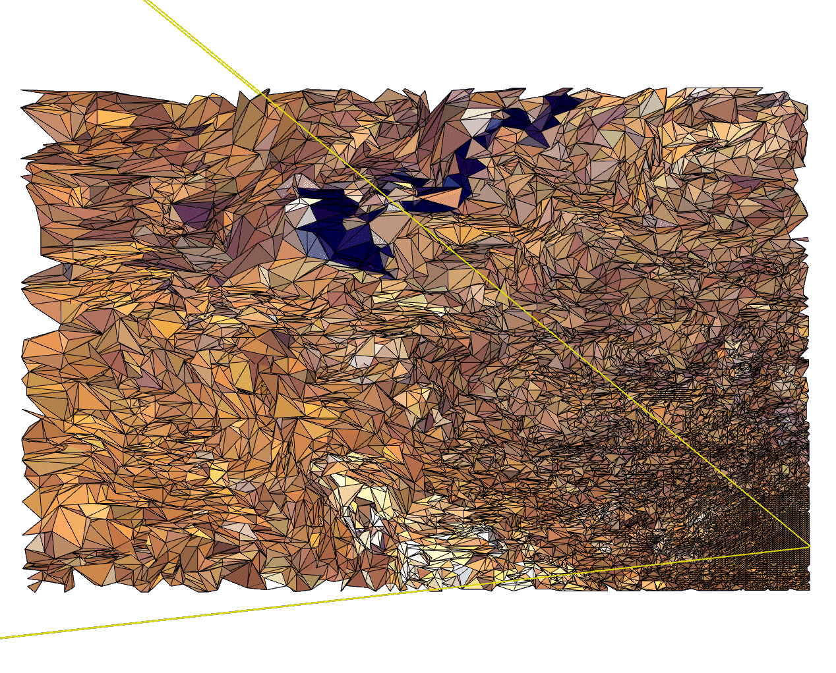
View-Dependent LOD: Examples
Show nearby portions of object at higher resolution than distant portions
View from eyepoint
Birds-eye view

Slide 22
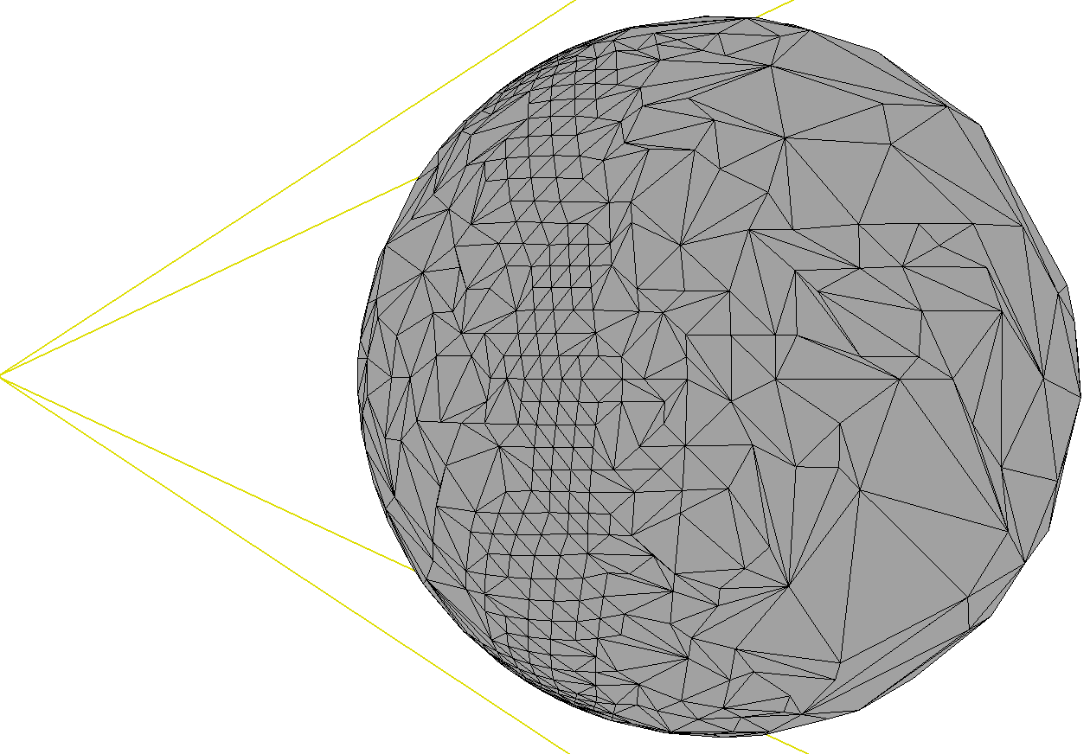
View-Dependent LOD: Examples
Show silhouette regions of object at higher resolution than interior regions
Notes:
Silhouette: 轮廓

Slide 23
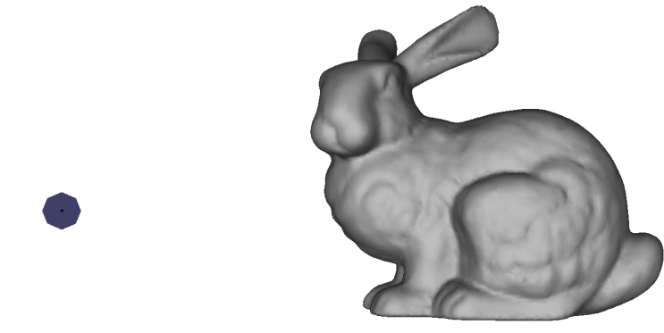
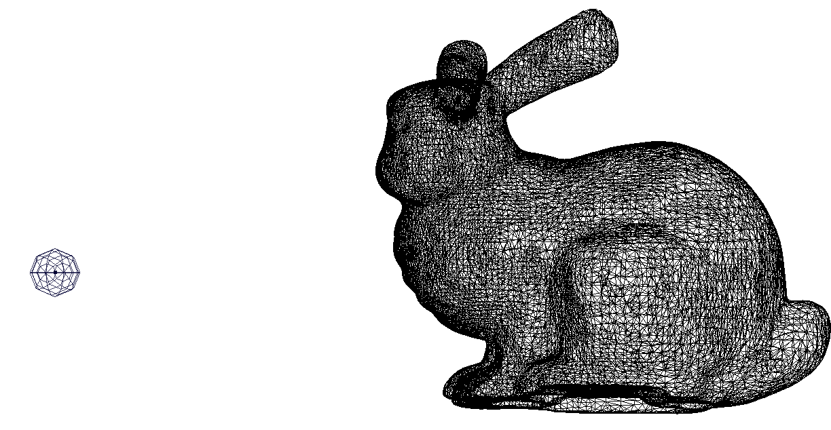
View-Dependent LOD: Examples
Show more detail where the user is looking than in their peripheral vision:
34,321 triangles

Slide 24
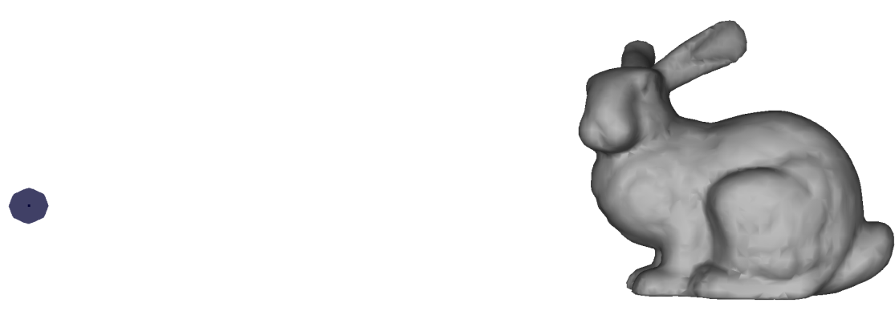
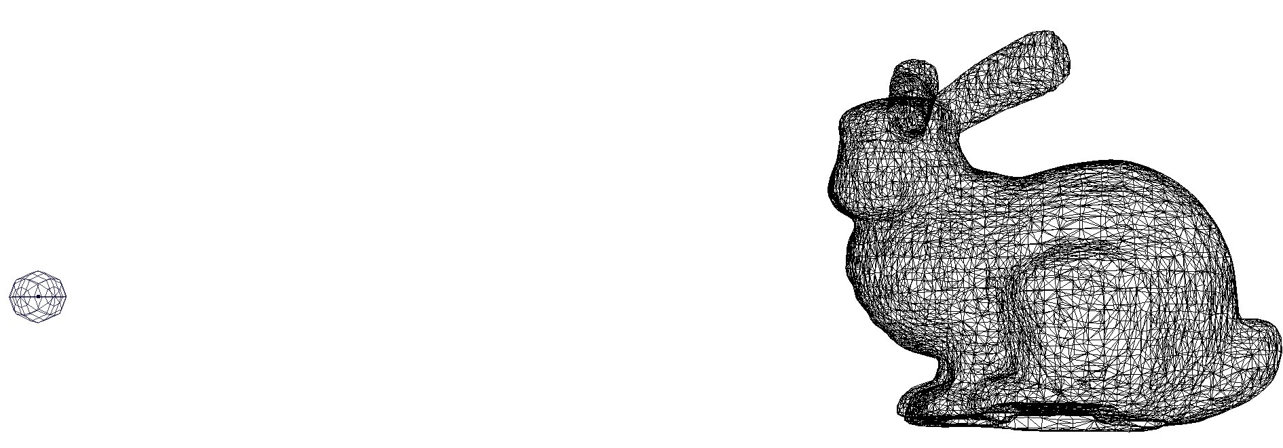
View-Dependent LOD: Examples
Show more detail where the user is looking than in their peripheral vision:
11,726 triangles
Notes:
peripheral vision：周围视觉

Slide 25
View-Dependent LOD: Advantages
Even better granularity
  Allocates polygons where they are most needed, within as well as among objects
  Enables even better overall fidelity
Enables drastic simplification of
very large objects
  Example: stadium model
  Example: terrain flyover

Slide 26
An Aside: Hierarchical LOD
View-dependent LOD solves the
Problem With Large Objects
Hierarchical LOD can solve the
Problem With Small Objects
  Merge objects into assemblies
  At sufficient distances, simplify assemblies, not individual objects
  How to represent this in a scene graph?

Slide 27
An Aside:Hierarchical LOD
Hierarchical LOD dovetails nicely with view-dependent LOD
  Treat the entire scene as a single object to be simplified in view-dependent fashion
Hierarchical LOD can also sit atop traditional discrete LOD schemes
  Imposters [Maciel 95]
  HLODs [Erikson 01]
Notes:
dovetail：n.楔形榫头，v.与…吻合

Slide 28
Summary: LOD Frameworks
Discrete LOD
  Generate a handful of LODs for each object
Continuous LOD (CLOD)
  Generate data structure for each object from which a spectrum of detail can be extracted

Slide 29
Summary: LOD Frameworks
View-dependent LOD
  Generate data structure from which an LOD specialized to the current view parameters can be generated on the fly.
  One object may span multiple levels of detail
Hierarchical LOD
  Aggregate objects into assemblies with their own LODs

Slide 30
Choosing LODs:
LOD Run-Time Management
Fundamental LOD issue: where in the scene to allocate detail?
  For discrete LOD this equates to choosing which LOD will represent each object
  Run every frame on every object; keep it fast

Slide 31
Choosing LODs
Describe a simple method for the system to choose LODs
  Assign each LOD a range of distances
  Calculate distance from viewer to object
  Use corresponding LOD
How might we implement this in a scene-graph based system?

Slide 32
Choosing LODs
What’s wrong with this simple approach?
  Visual “pop” when switching LODs can be disconcerting
  Doesn’t maintain constant frame rate; lots of objects still means slow frame times
  Requires someone to assign switching distances by hand
  Correct switching distance may vary with field of view, resolution, etc.
What can we do about each of these?

Slide 33
Choosing LODs:
Maintaining constant frame rate
One solution: scale LOD switching distances by a “bias”
  Implement a feedback mechanism:
    If last frame took too long, decrease bias
    If last frame took too little time, increase bias
  Dangers:
    Oscillation caused by overly aggressive feedback
    Sudden change in rendering load can still cause overly long frame times

Slide 34
Choosing LODs:
Maintaining constant frame rate
A better (but harder) solution: predictive LOD selection
For each LOD estimate:
  Cost (rendering time)
    # of polygons
    How large on screen
    Vertex processing load (e.g., lighting)
    Fragment processing load (e.g., texturing)
  Benefit (importance to the image)

Slide 35
Choosing LODs:
Maintaining constant frame rate
For each LOD estimate:
  Cost (rendering time)
  Benefit (importance to the image)
    Size: larger objects contribute more to image
    Accuracy: no of verts/polys, shading model, etc.
    Priority: account for inherent importance
    Eccentricity: peripheral objects harder to see
    Velocity: fast-moving objects harder to see
    Hysteresis: avoid flicker; use previous frame state
Notes:
Eccentricity：偏心
Hysteresis：滞后

Slide 36
二、网格压缩传输技术
场景绘制的速度受到场景中三角形数目的制约，在绘制一个三角形时，必须将其全部三个顶点的信息传送到图形硬件
为避免同一顶点信息的重复传送，大多数图形API均采用三角形带和三角形扇等复合三角形结构进行传输，以充分利用图形硬件的有限带宽

Slide 37
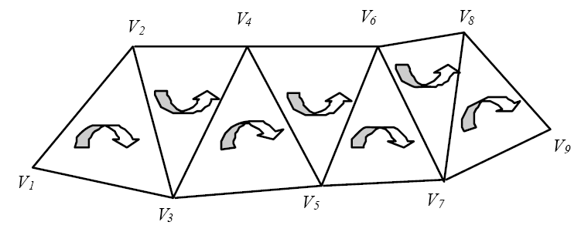
二、网格压缩传输技术
三角形带（Triangle Strips）
  n个顶点的顺序三角形定义为顶点序列：{v₁,v₂,…v_{n}},其中三角形i为Δv_{i}v_{i＋1}v_{i＋2}

Slide 38
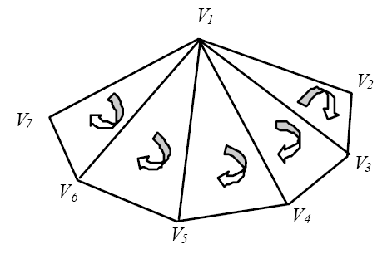
二、网格压缩传输技术
三角形扇（Triangle Fans）
  n个顶点的顺序三角形定义为顶点序列：{v₁,v₂,…v_{n}},其中三角形i为Δv₁v_{i＋1}v_{i＋2}

Slide 39
二、网格压缩传输技术
采用类似于三角形带或三角形扇这样的复合结构，将把处理与传输m个三角形的代价从3m个顶点降到（m＋2）个顶点
如果应用程序的瓶颈为填充率时，很难使用这种方法提高系统性能
  填充率：每秒可填充的像素数量

Slide 40
二、网格压缩传输技术
给定一个任意的三角形网格，最好能快速、高效地将其分解为三角形条带
给定任意的三角形网格，如何获得最优的三角形条带问题已被证明为NP完全问题，必须使用启发式方法获得最接近的条带数目
已有多种方法可自动生成三角形带
  改进的SGI三角形带生成方法

Slide 41
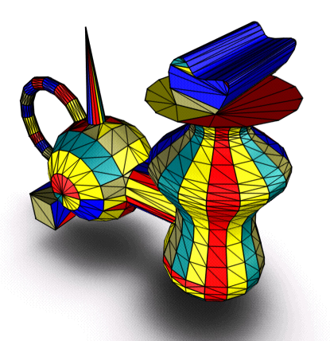
二、网格压缩传输技术
由三角形带/三角形扇/三角形混合表示的物体示例

Slide 42
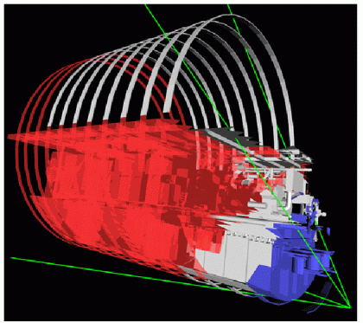
三、遮挡剔除技术
在对场景作取景变换之前剔除场景中对于当前视点不可见的某些物体的整体或局部，从而加速场景的绘制

Slide 43
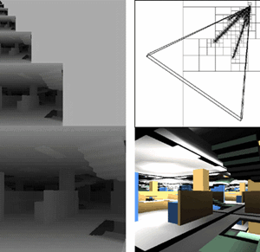
三、遮挡剔除技术
为实现遮挡剔除，需要对物体进行可见性检查
  物体的可见性检查一般在场景数据组织阶段由计算机CPU计算完成，不涉及到图形硬件
  针对当前视点，预计算其可能可见的所有面片的集合

Slide 44
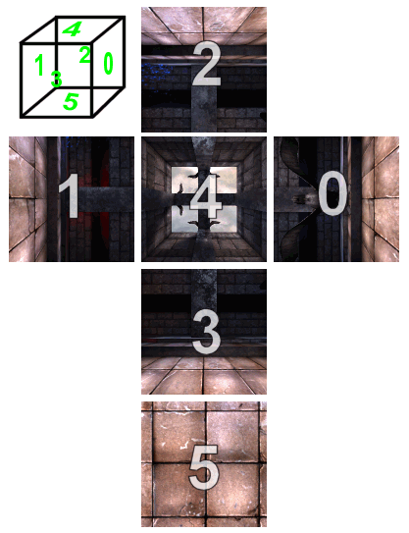
四、IBR技术
以待绘制的场景的一系列二维图像作为输入，通过将其画面像素重新整合来生成在新的视点和新的视线方向上的场景画面
前身是环境映射技术
QuickTime VR系统简介
  场景漫游系统
  http://www.apple.com/quicktime/technologies/qtvr/

Slide 45
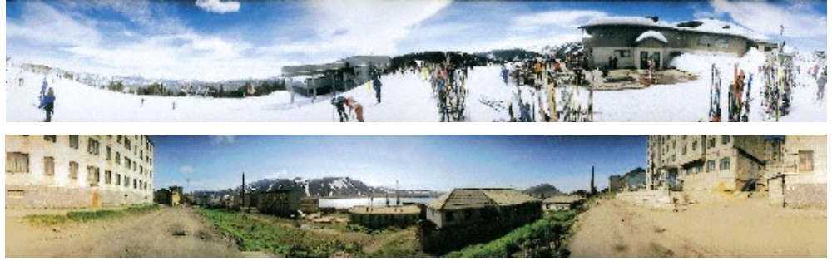
四、IBR技术
全景相机拍摄的全景图

Slide 46
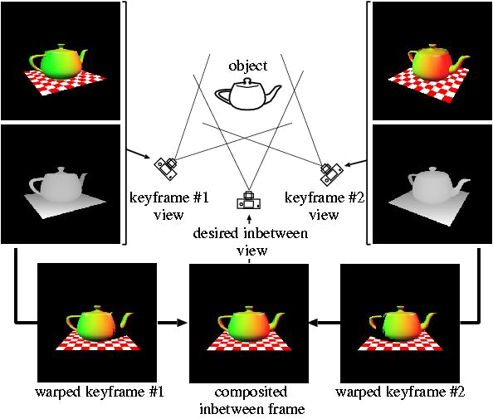
四、IBR技术

Slide 47
四、IBR技术
优点
  无需进行复杂的场景几何造型即可实现对场景的浏览、漫游
  绘制计算量与场景的几何复杂度无关，而仅与所需绘制的画面分辨率有关
缺点
  仅适用于静态场景，用户无法与场景中的景物进行实时交互
  绘制质量在很大程度上取决于原始图像的采样数目和相应的插值方法

